Slide 1
Lecture 1: Introduction to Machine Learning in Python
Classifiers and linear regression
Dr. Anders S. Christensen
University of Basel, May 2020

Slide 2
About the course
About the course:
Day 1: (Lecture + Exercise #1)
Exploratory Data Analysis (EDA)
  Pandas (data), Seaborn (plotting)
Linear regression
  Numpy
Introduction to Scikit-learn
Day 2: (Lecture + Exercises #2)
Molecules and representations
Kernel ridge regression
  Numpy & QML
Benchmarking
Day 3: (Lecture, some students)
Introduction to neural networks
Fitting a curve with a neural network
  Numpy
Building a feed-forward neural network
  PyTorch
NOTE: Exercises #2 are graded!
Deadline Tuesday 19/5-2020 (midnight)

Slide 3
Introduction to Machine Learning in Python
What is artificial intelligence and machine learning?
Intelligence?
Machine learning:
Approximate x → y as some function ỹ(x)
“Learning” from training data

Slide 4
Program for today
1st part of lecture:
Classifier for the Iris dataset (Pandas, Seaborn, and Scikit-Learn)
2nd part of lecture:
Linear Least Squares Regression for a 1-D function (Numpy)
ML Exercises #1:
Linear Regression for Boston housing prices (Numpy and Scikit-Learn)

Slide 5
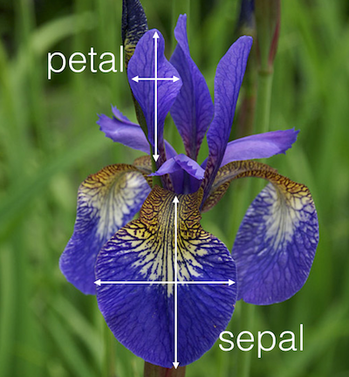
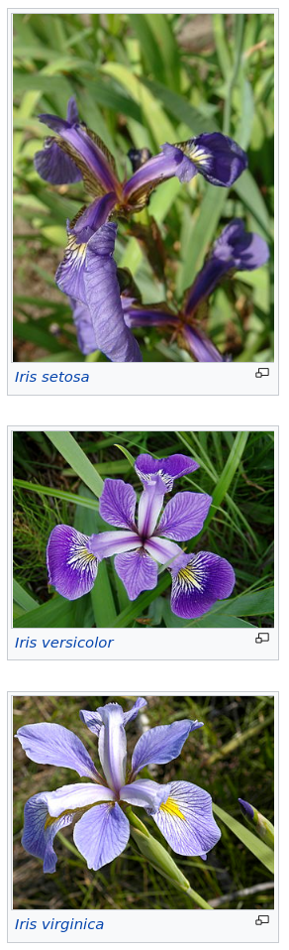
Part 1: Fisher’s Iris Data Set
Created by biologist Ronald Fisher in 1936
Classifying flower species by petals and sepals measurements?
Common example for in data science and data analysis
Step 1 is often “Exploratory Data Analysis” (EDA).
“In statistics, exploratory data analysis (EDA) is an approach to analyzing data sets to summarize their main characteristics, often with visual methods.” - Wikipedia
⇒ Pandas (data) & Seaborn (plotting) frameworks in Python!

Slide 6
Lecture 2: Introduction to Machine Learning in Python
Kernel ridge regression and molecules
Dr. Anders S. Christensen
University of Basel, May 2020

Slide 7
Introduction to
What was hard/impossible last lecture?
Today:
When linear regression fails?
  Linear regression -> kernel ridge regression
How to handle molecules
Introduction to Exercises #2

Slide 8
Lecture 3: Introduction to Machine Learning with Python
Introduction to Neural Networks
Dr. Anders S. Christensen
University of Basel, May 2020

Slide 9
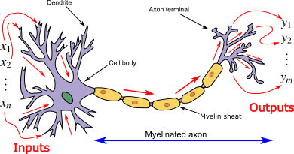
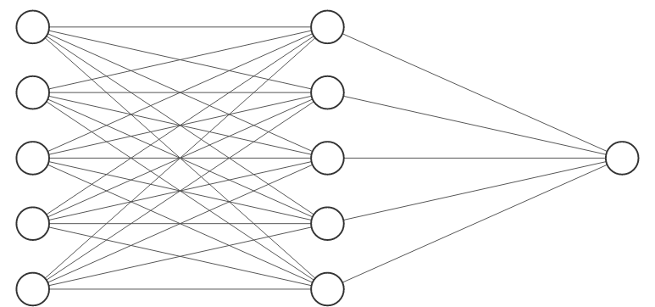
Introduction to Artificial Neural Networks (and Deep Learning)
Machine learning approach inspired by interconnected neurons in a biological brain
Most often consists of connected layers with specific mathematical operations
Can model very nonlinear functions
“Deep Learning” is NNs with >3 layers
Loc Vu-Quoc (2018)

Slide 10
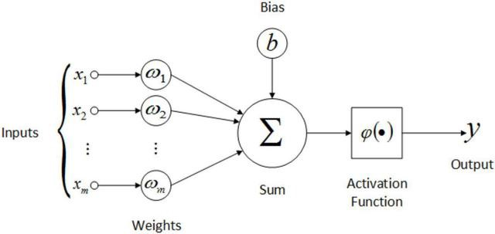
Connections between nodes/artificial neurons
Last time: (e.g. linear regression)
y = w⋅x + b w = “slope” b = “offset”
Neural Networks:
y = w⋅x + b w = “weight” b = “bias”
An example “neuron”:
y = φ(x₁w₁+x₂w₂ + … + b)
Q: Number of parameters?

Slide 11
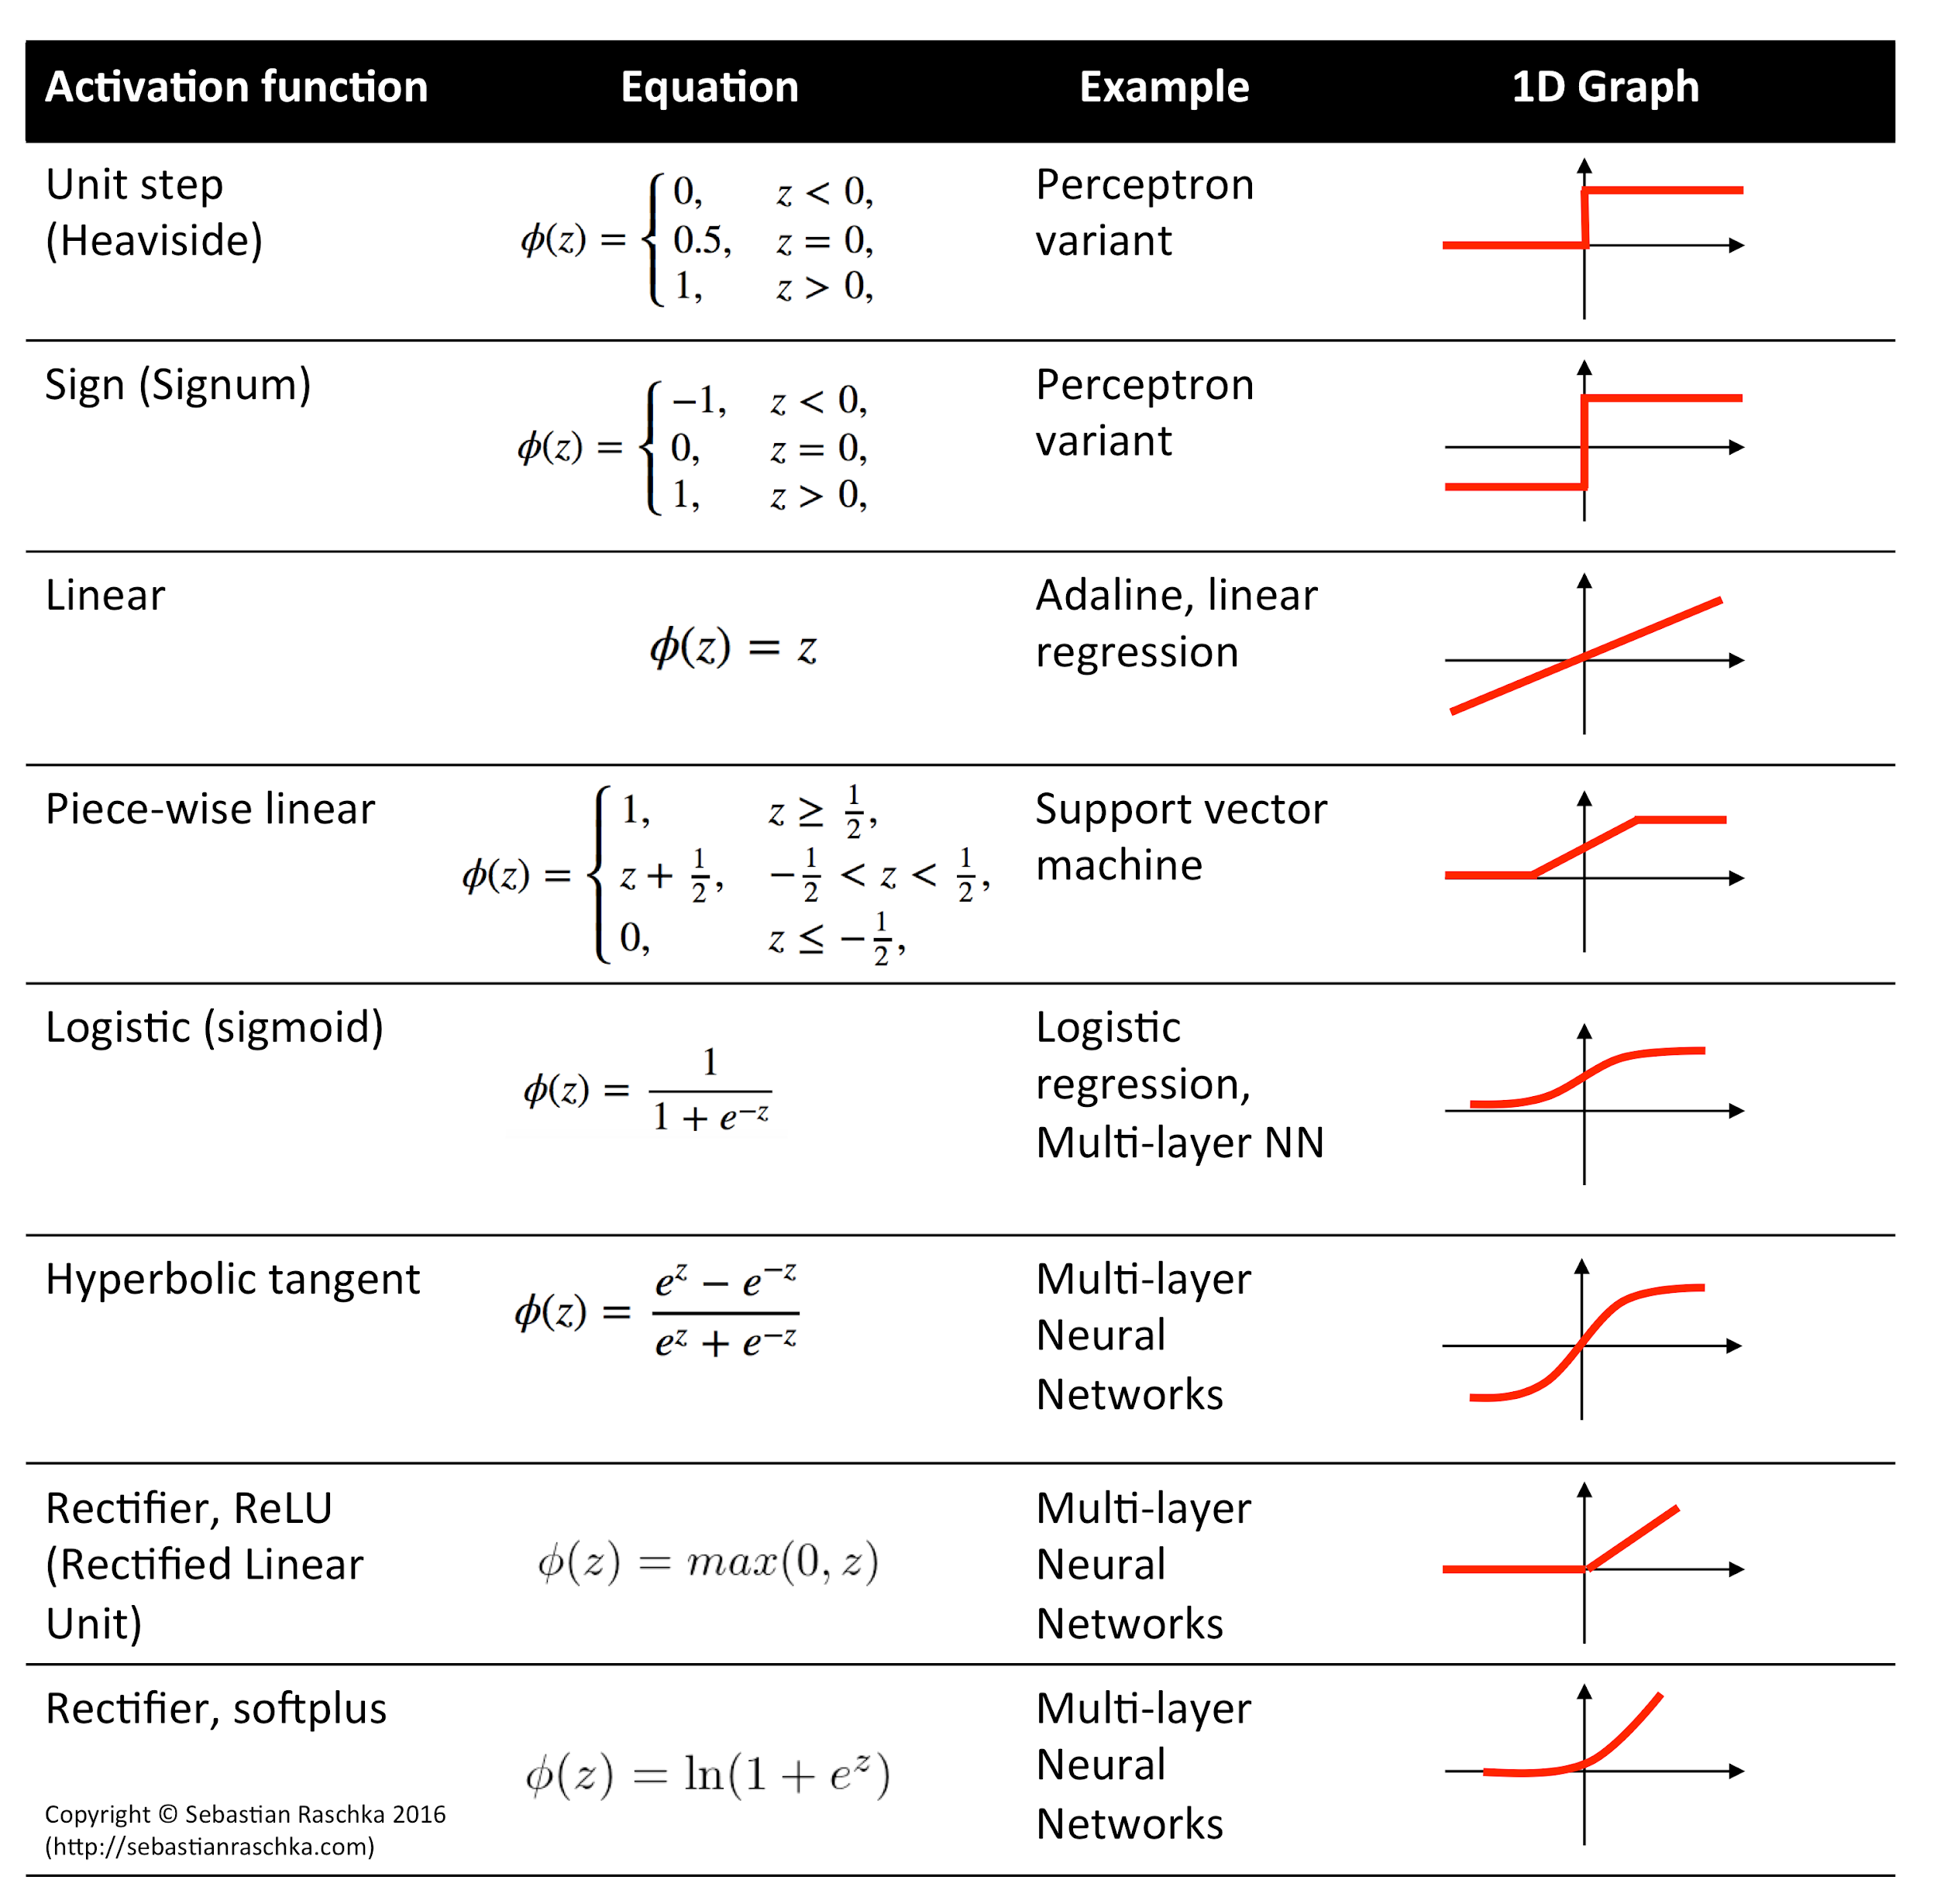
Activation Functions
Source:
https://rasbt.github.io/mlxtend/

Slide 12
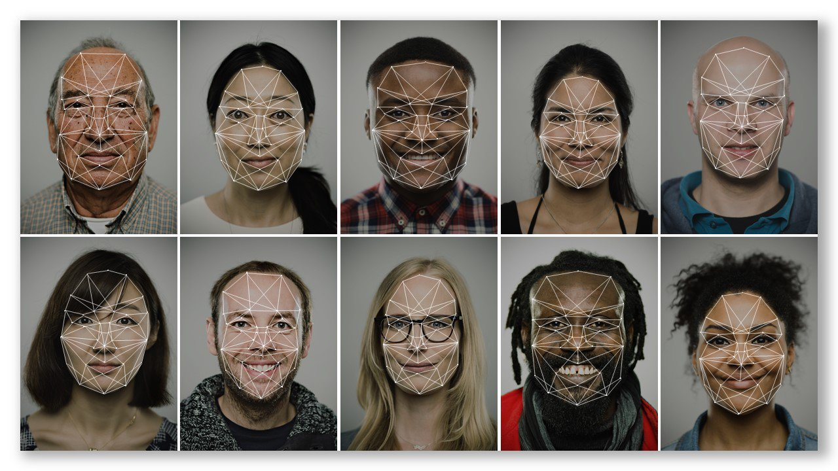
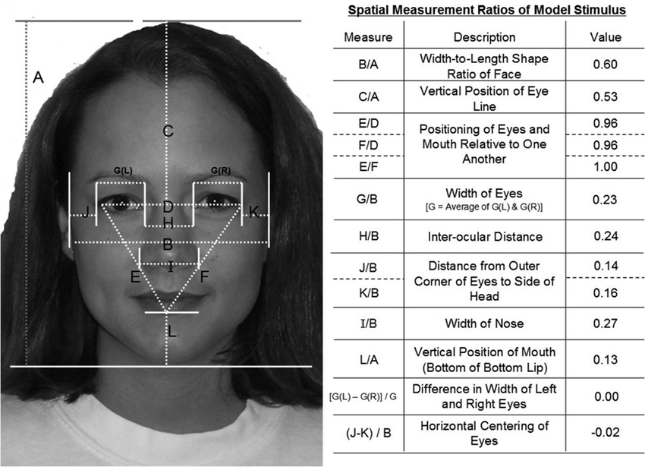
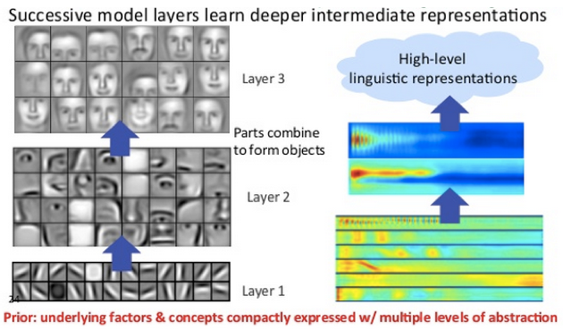
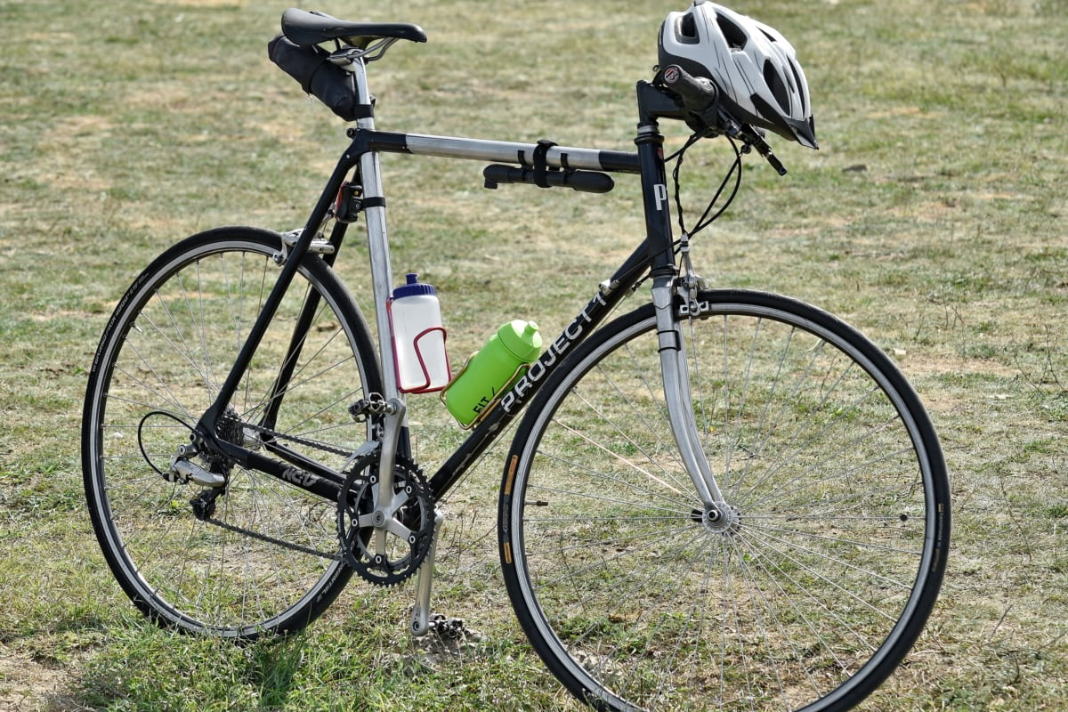

Example use case?
Feature engineering?
DOI: 10.1037/a0037558
DOI: 10.1037/a0037558
Source: medium.com
Input data = raw pixels
Let the neural network
“learn” how to
represent/handle data

Slide 13
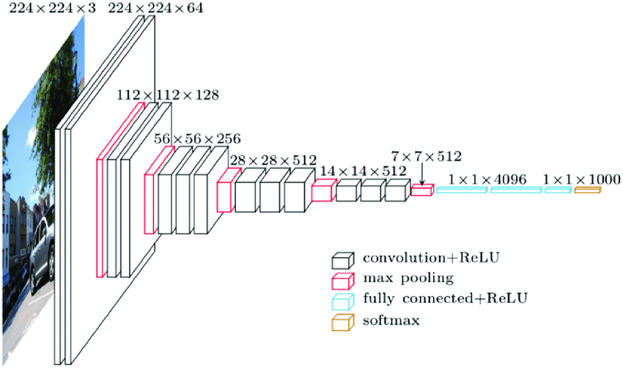
Image recognition example: VGG16
For example: VGG16 (Simonyan and Zisserman, 2014), with 138 million parameters

Slide 14
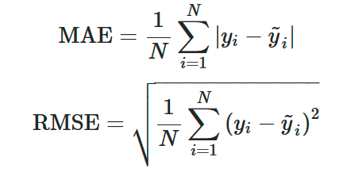

How to optimize the weights?
Forward propagation:
Calculating output from input
Backward propagation (“backprop”)
Calculating derivative of loss function wrt. params
Many partial derivatives using the chain-rule, e.g.
Most implementations: Automated differentiation

Slide 15
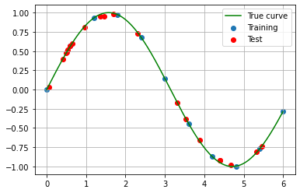
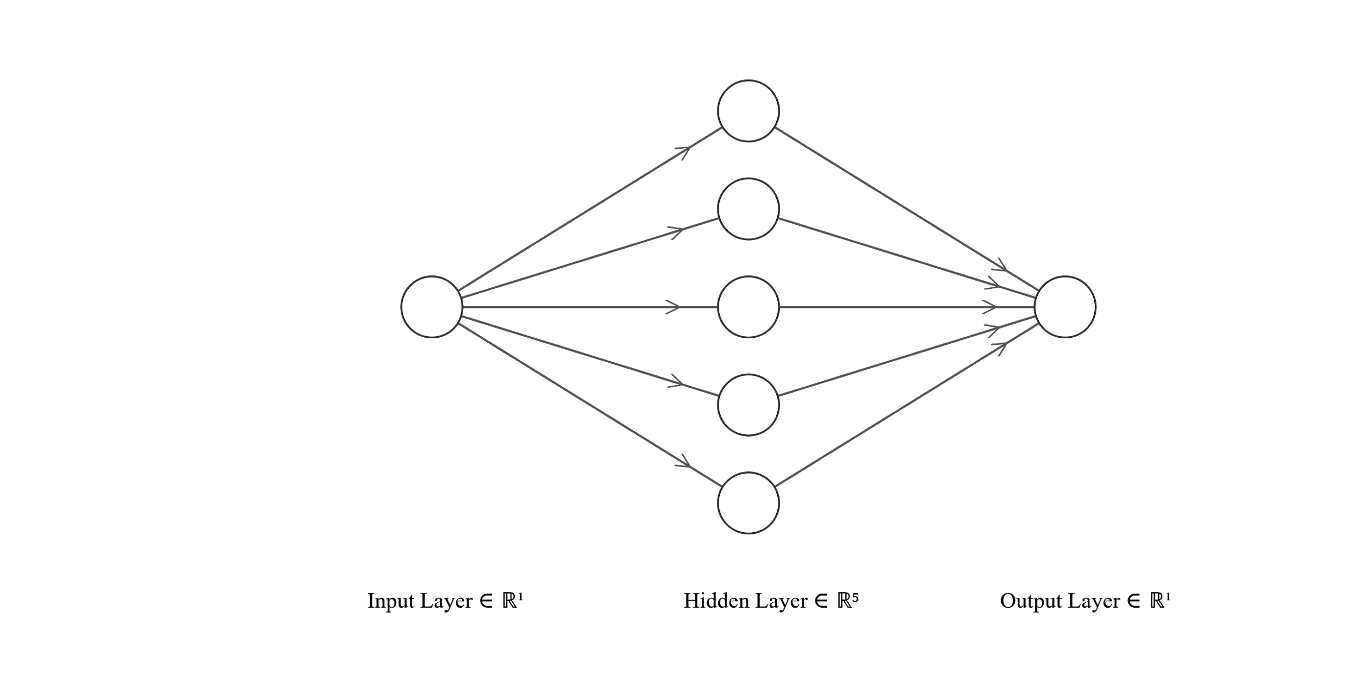
Coding a Simple Artificial Neural Network in Numpy
Fully connected NN with 1 hidden layer.
Input layer: x-value
Hidden layer: Sigmoid functions
Output layer: sum()
y(x) = sin(x)
Today: Numpy implementation

Slide 16
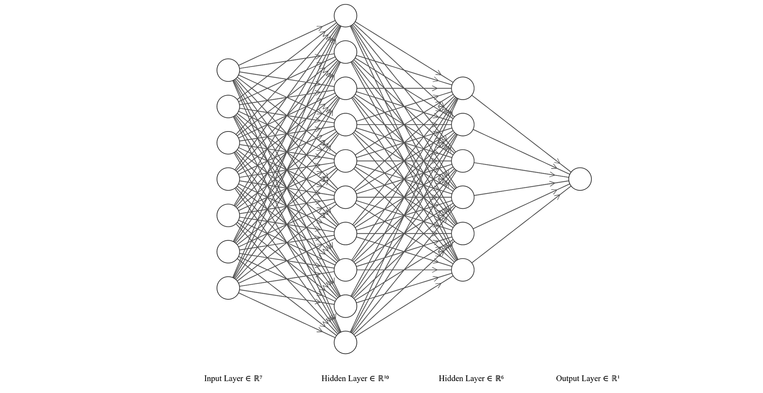
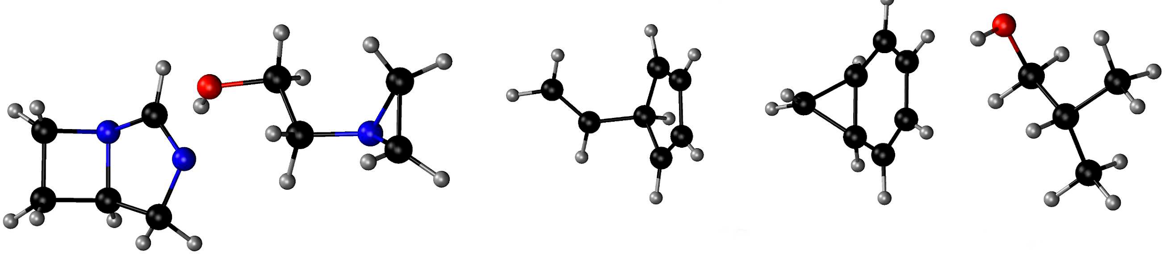
Deep Learning with GPUs in Python (PyTorch)
Atomization energy of QM7 molecules
Fully connected with two hidden layers.
Input layer: Molecule representation
Hidden layer: activation functions
Hidden layer: activation functions
Output: Sum (atomization energy)
Too complicated for Numpy: PyTorch+GPU

Slide 17
Suggested resources:
Machine Learning Basics: Online course for learning ML in Python
https://sites.google.com/view/ml-basics/home
Keras: High-level API for TensorFlow
https://keras.io/examples/
PyTorch: The framework we using today
https://pytorch.org/tutorials/

